Slide 1



Modeling of Hydrogen Refueling Systems for Trains
ID430
12 March 2026
Parallel Session 4: Room G
Thursday 12 March: 18:10-18:30
Maritime, Rail and Aviation Applications
OPEN
EHEC 2026 – European Hydrogen Energy Conference
11-13 March 2026
Seville, Spain
Øystein Ulleberg
Chief Scientist, Institute for Energy Technology
Professor, University of Oslo, Norway

Slide 2
Contents
OPEN
01 | Background
02 | Rail4EARTH HRS Modeling Study
03 | Conclusions

Slide 3
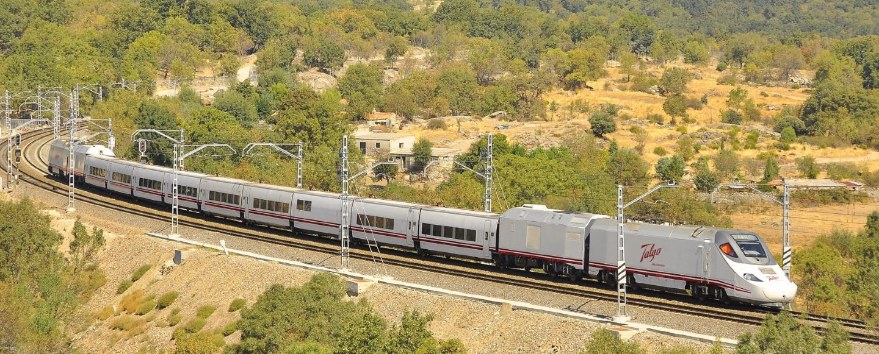
Background & Motivation
OPEN
GHG-emissions
  Railway applications contribute to ca. 1% of global emissions
  Europe railway network: 43% diesel
Zero Emission
  Battery and hydrogen electric propulsion systems can be used
  on non-electrified lines
Rail4EARTH Goals – Operating Range
Autonomous range (passenger trains):
  Battery electric: < 200 km
  Hydrogen electric: > 200 km
High-Speed Passenger Train in Spain (Photo: Talgo)

Slide 4
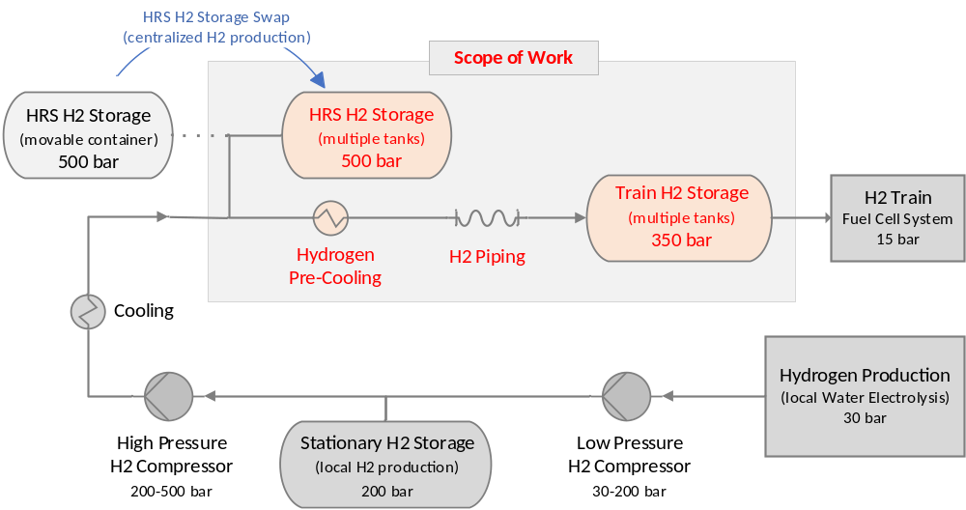
Scope of Work
OPEN
Design & Operation of stationary
Hydrogen Refueling Systems
(railway side)
Design & Operation of onboard
Hydrogen Storage Systems
(train side)
Interfaces between HRS and train H2-storage systems
Pre-Standardization
Guidelines for standardization

Slide 5
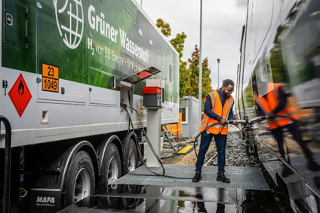
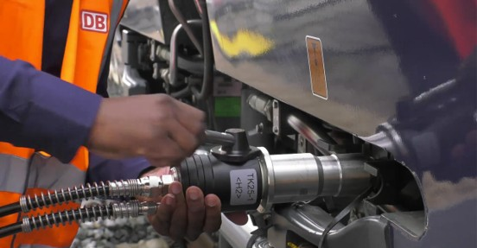
Rail4EARTH HRS – Working Group
OPEN
Train H2 Storage Systems Demands & Requirements
  FCH2RAIL/DLR (EU)
  Talgo (Spain)
Hydrogen Refueling System Demands & Requirements
  DB Engie (Germany)
  ADIF (Spain)
Interfaces between HRS & H2 Storage Systems
  Talgo (Spain)
  Lukasiewicz IEL (Poland)
Pre-Standardization
  DB Engie (Germany)
  RISE (Sweden)
Hydrogen Refueling of a Train in Germany
(Photos: DB Engie)

Slide 6
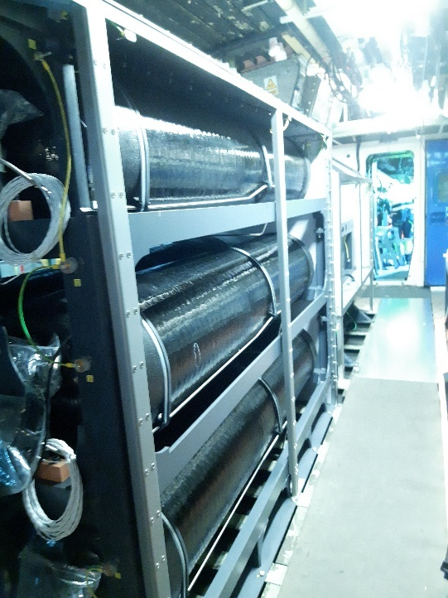
Railway Requirements
OPEN
Hydrogen Demand:
  < 50 kg for shunting locomotives
  < 250 kg for passenger trains
Hydrogen Storage:
  Type IV composite tank technology
  Train hydrogen storage: @350 bar
Hydrogen Refueling:
  No standard fueling protocol exists
  Refueling within 30 minutes
Train Hydrogen Storage
(Photo: Talgo)

Slide 7
Contents
OPEN
01 | Background
02 | Rail4EARTH HRS Modeling Study
03 | Conclusions

Slide 8
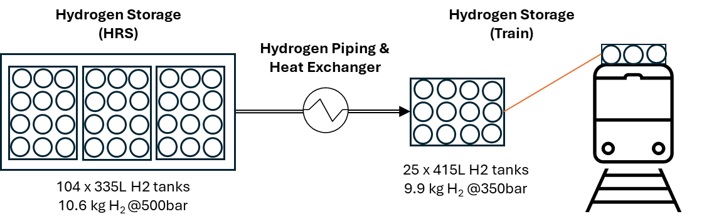
Modeling Case Study
OPEN
Overall Goal: Model and study different system designs and operating schemes for railway HRS
Specific Goals: Determine filling time & state of charge (SOC) of train hydrogen storage for specific HRS
Methodology: Modeling of “tank-to-tank” filling
250 kg @350 bar
1100 kg @500 bar

Slide 9
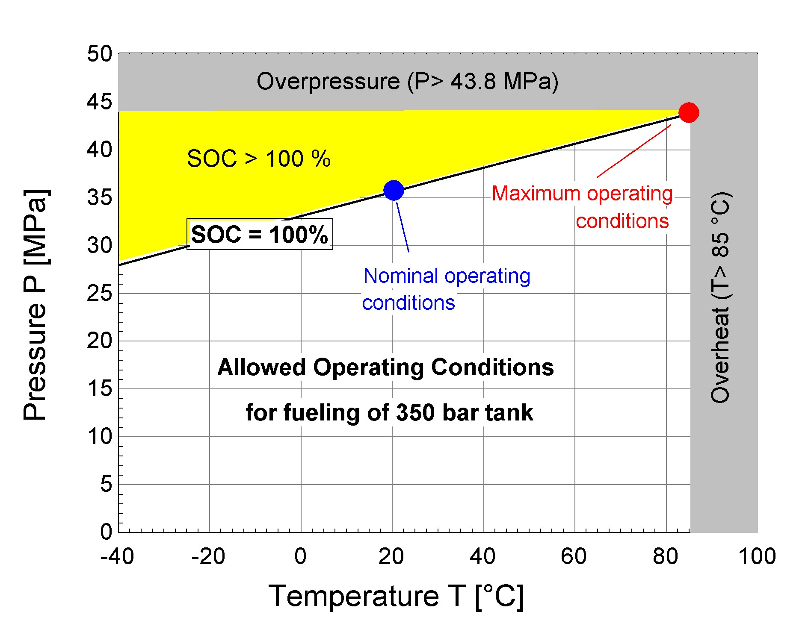

HRS Thermodynamics
OPEN
Pressure (MPa) and Temperature (°C) limits for a 350 bar (35 MPa) hydrogen storage tanks
Modeling
Tool
Engineering
Equation
Solver
Notes:
Illustration of temperature and pressure limits for a 350 bar (35 MPa) hydrogen refueling process according to SAE J2601-2.
Ideal operating conditions required to achieve 100% state of charge (black line marked SOC=100%) and nominal operating conditions (blue dot).

Slide 10
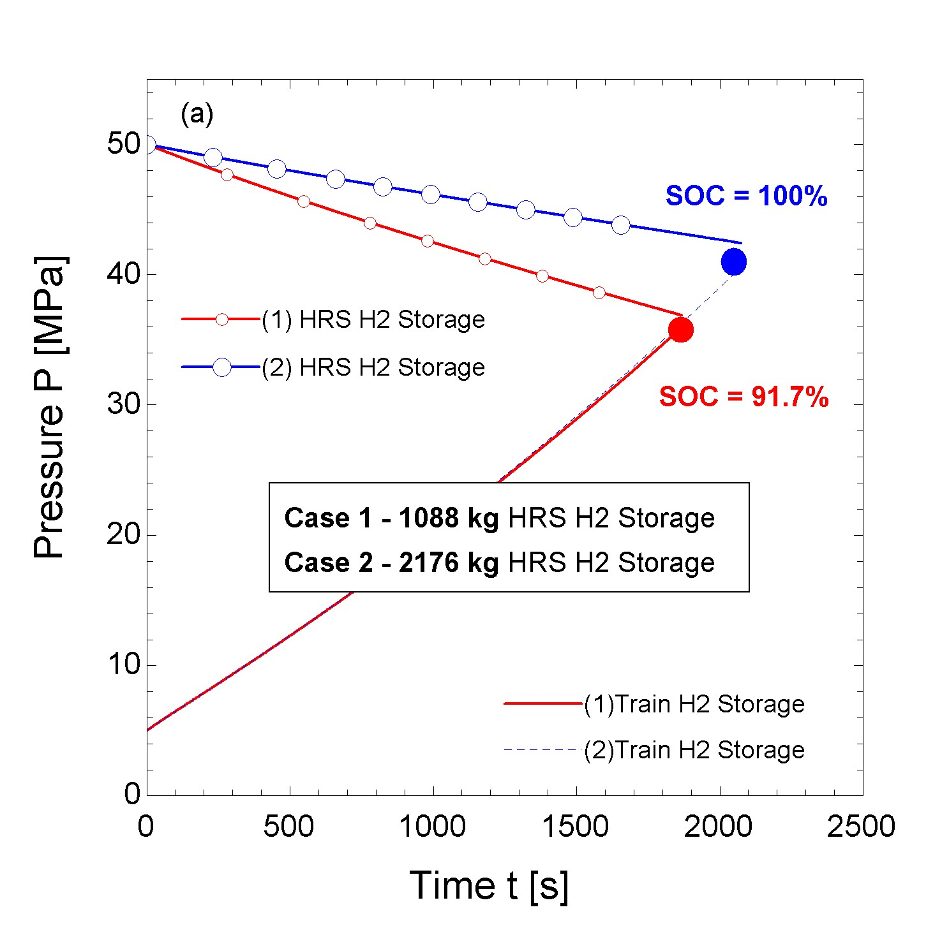
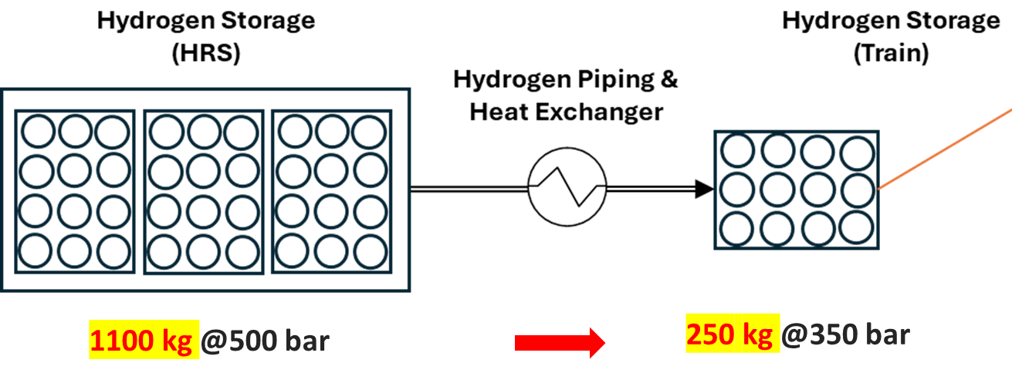
Pressures during H2-refueling
OPEN
Pressures in H2 storage systems for two different HRS designs (1088 kg vs. 2176 kg)
Reference System (Case 1)

Slide 11
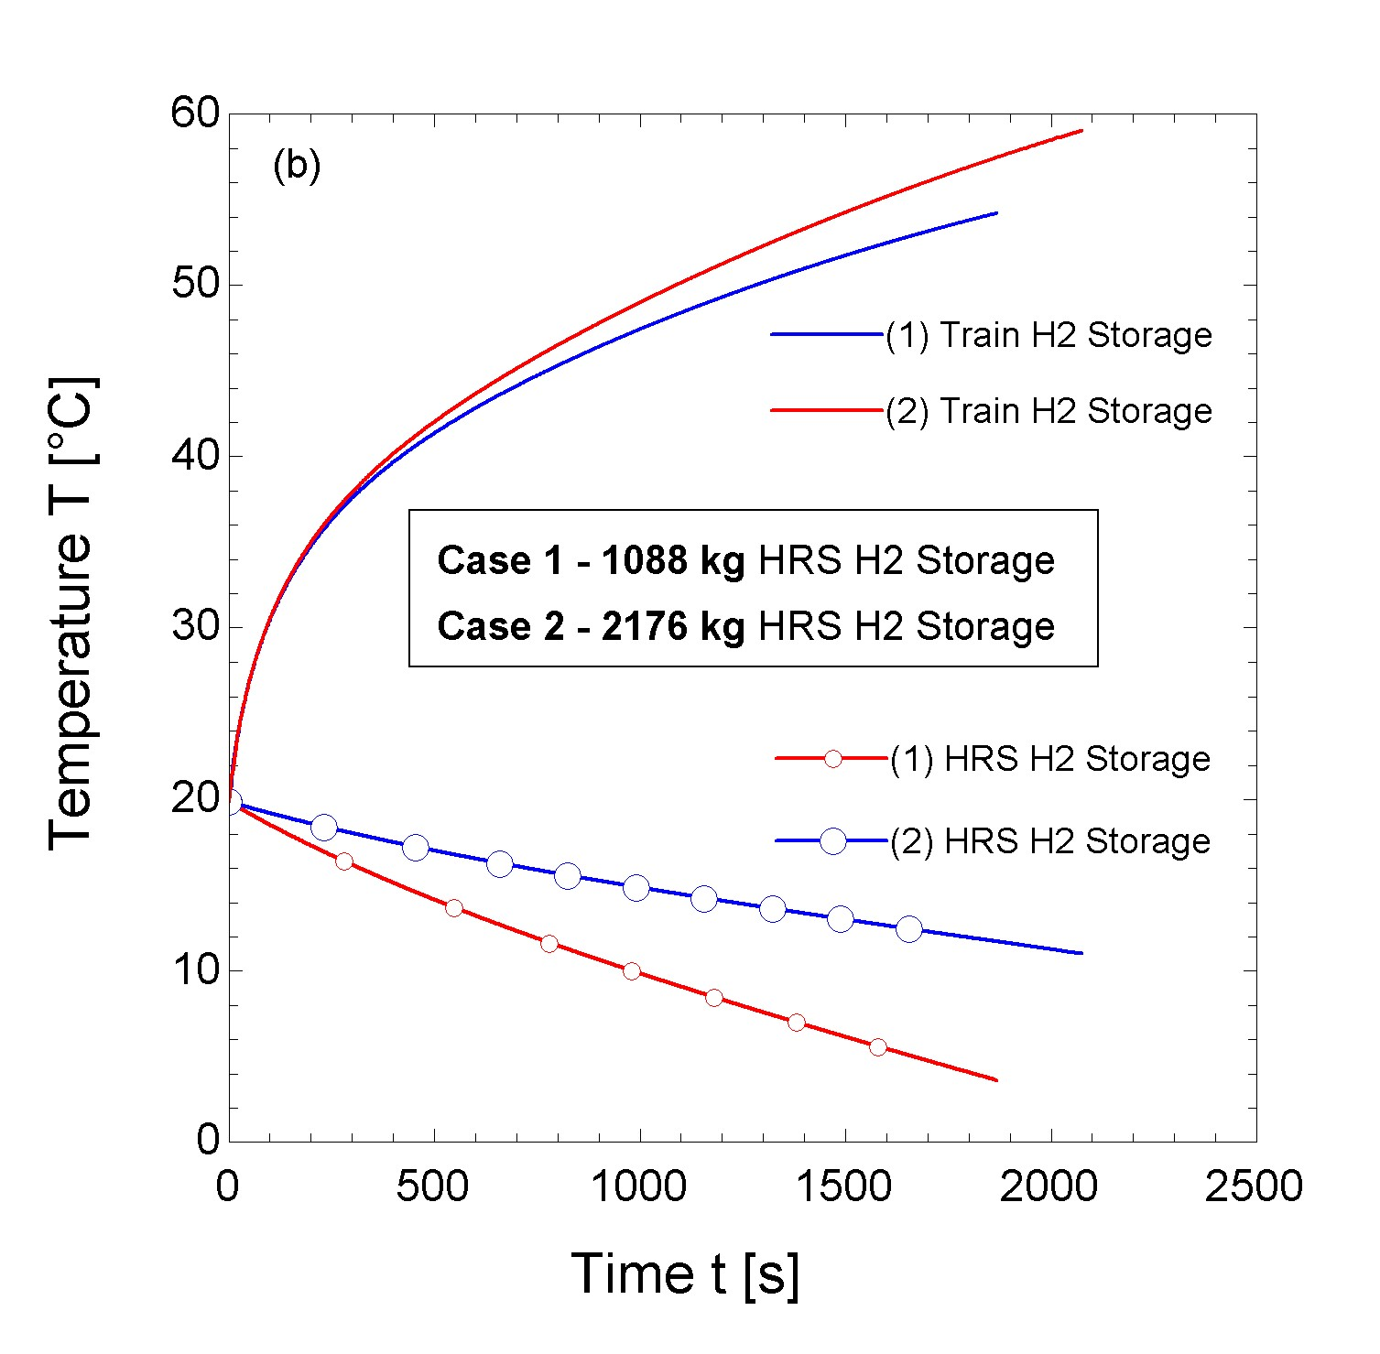
Temperatures during H2-refueling
OPEN
Temperatures in H2 storage systems for two different HRS designs (1088 kg vs. 2176 kg)
Reference System (Case 1)

Slide 12
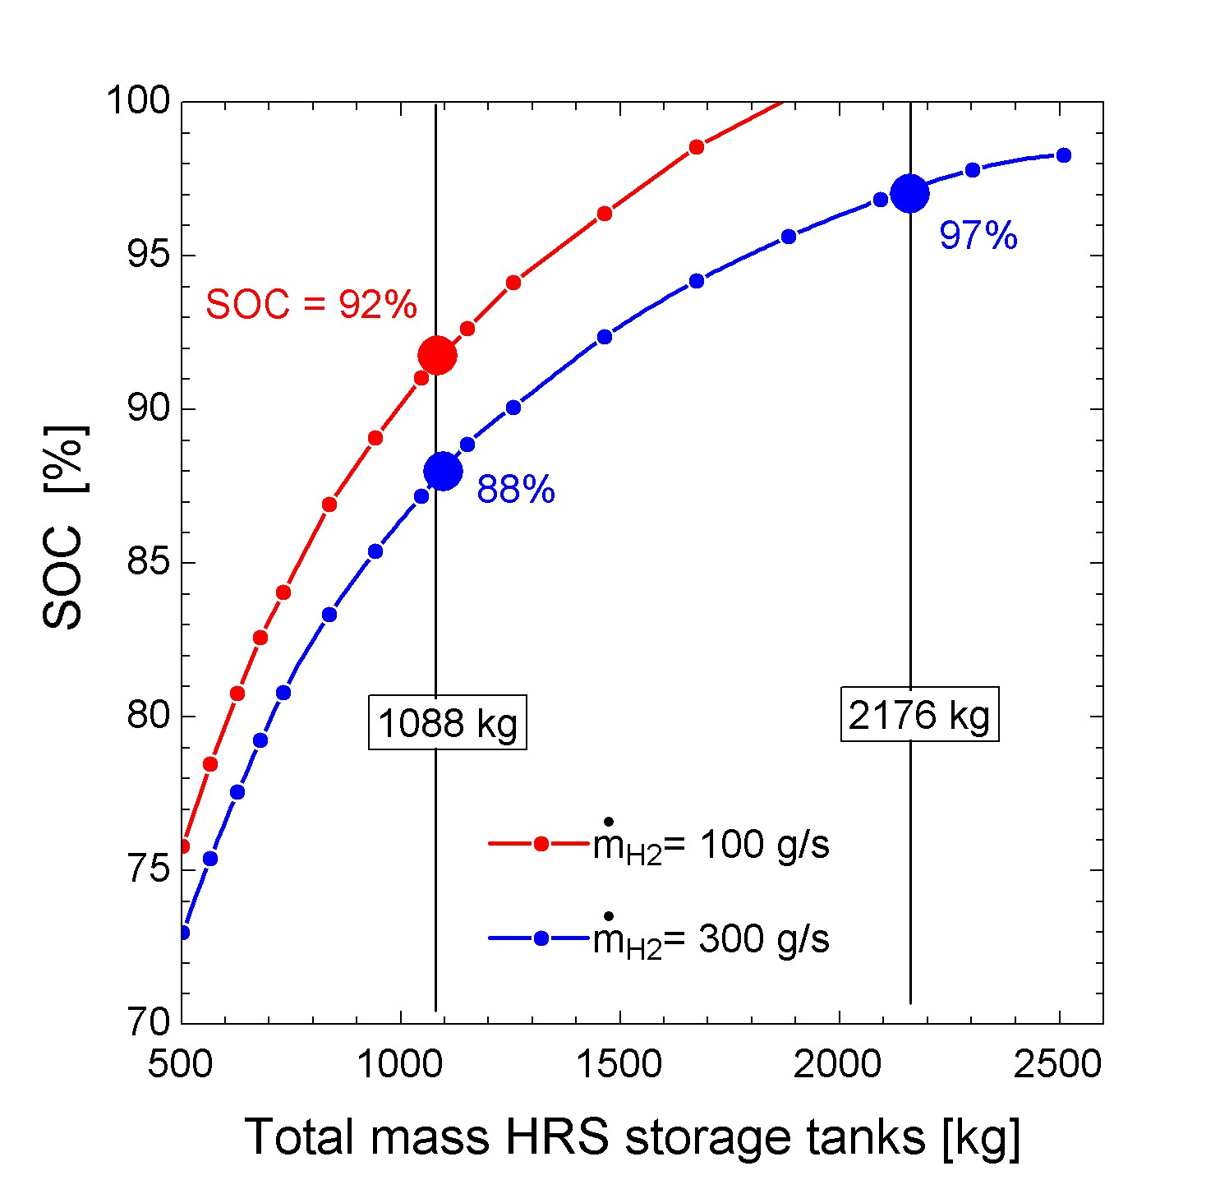
State of Charge (SOC)
OPEN
Final SOC in train H2-storage vs. HRS H2-storage size (kg) and H2 filling rate (g/s)
Results @100 g/s
HRS Hydrogen Storage |  | Train Hydrogen Storage
Storage Size (kg) | No. of tanks* (#) | Final Temp. (ºC) | Final Pressure (bar) | Final SOC (%) | Filling Time (min)
2176 | 208 | 59.0 | 405 | 99.9 | 35
1088 | 104 | 54.2 | 359 | 91.7 | 31
795 | 78 | 51.4 | 331 | 86.3 | 29
502 | 48 | 46.0 | 279 | 75.8 | 25

Slide 13
Contents
OPEN
01 | Background
02 | Rail4EARTH HRS Modeling Study
03 | Conclusions

Slide 14
Summary & Conclusions
OPEN
HRS Design (Case Study)
    HRS storage: 1000 kg @500 bar
    “Tank-to-Tank” filling: 500 →350 bar
  HRS Operation
    Medium high mass flow: 100 g/s
    Reasonable pre-cooling rate (30 kW_{th})
Conclusions
    200 kg of hydrogen can be
    transferred in 30 minutes
    High final SOC > 90% can only be achieved with large HRS H2-storage
  Recommendations
    Refueling time: 30 minutes
    Refueling speed: 100 g/s

Slide 15
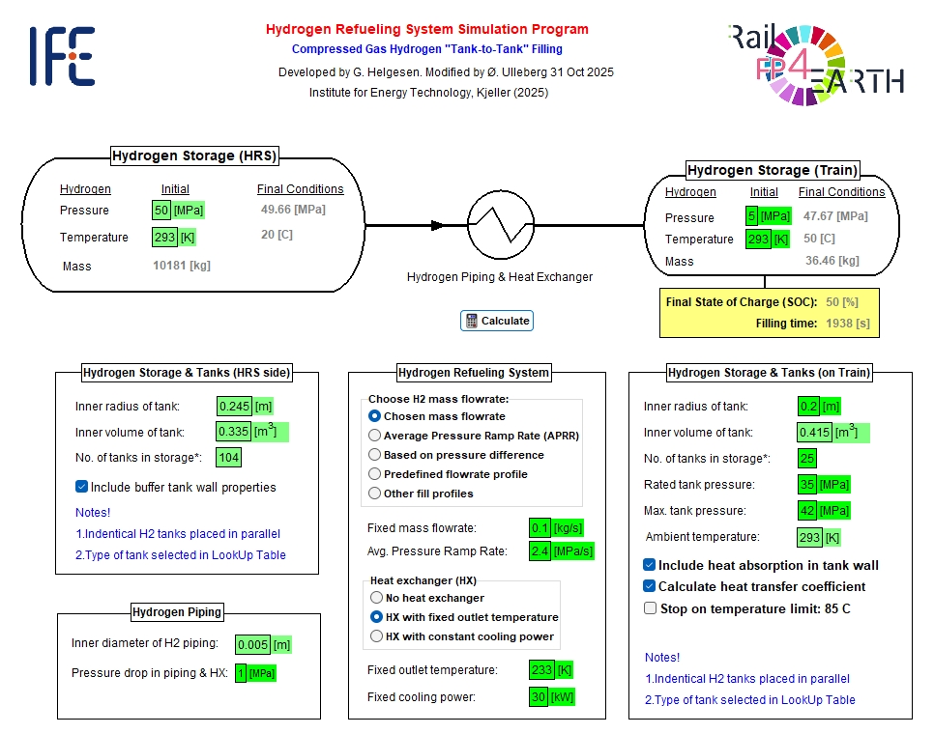

Future Work
OPEN
Perform
techno-economic studies
in EES
Create publicly available open-source code
in Python

Slide 16


Acknowledgements
OPEN
Geir Helgesen, IFE, Norway
Manuel Caballero Ocaña, Talgo, Spain
Boyu Yang, DB Energie GmbH, Germany
Charles Foncin, SNCF, France
Steffen Wieser, DLR Germany
Øystein Ulleberg
@LinkedIn
Disclaimer
This work is part of the Europe’s Rail project FP4-Rail4EARTH and supported and funded by the Europe's Rail Joint Undertaking of the
European Union and its members. Views and opinion expressed in this work are those of the author(s) only and
do not necessarily reflect those of the European Union or the Europe's Rail Joint Undertaking.

